Slide 1

Intelligent Surveillance
A smart approach for the automatic surveillance with CCTVs
Authors:
Federico Matarante 2133034
Serena Trovalusci 2128733

Slide 2

O U T L I N E
Final considerations
Introduction
Metrics
Dataset
Implementation details
Proposed method

Slide 3
INTRODUCTION
Surveillance Systems
Importance of CCTV cameras in maintaining security
Limitations of traditional surveillance:
Human monitoring: fatigue, inefficiency, and delay
Ineffective real-time crime prevention and intervention
Advancements in Computer Vision:
Automation of data processing and decision-making
Use of image analysis and machine learning for real-time monitoring
Potential to identify and respond to violent situations proactively

Slide 4
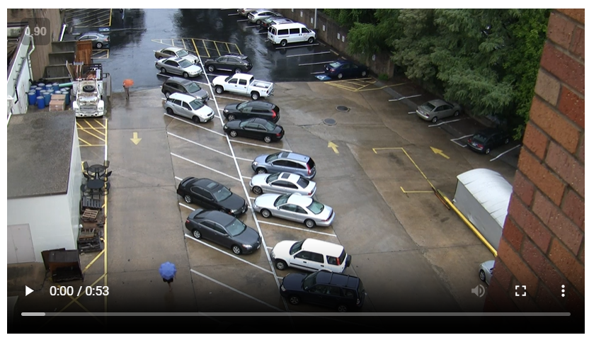
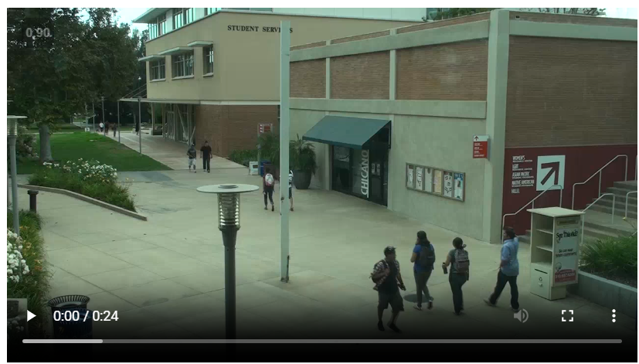
Virat Dataset
Dataset Structure and annotations
250 hours of ground camera videos
12.5 hours of annotated data of tracked objects and actions
13 labels of tracked objects
41 labels of events
For implementation issues it’s added one more extra label of event “No event”
VIRAT Video Data (viratdata.org)

Slide 5
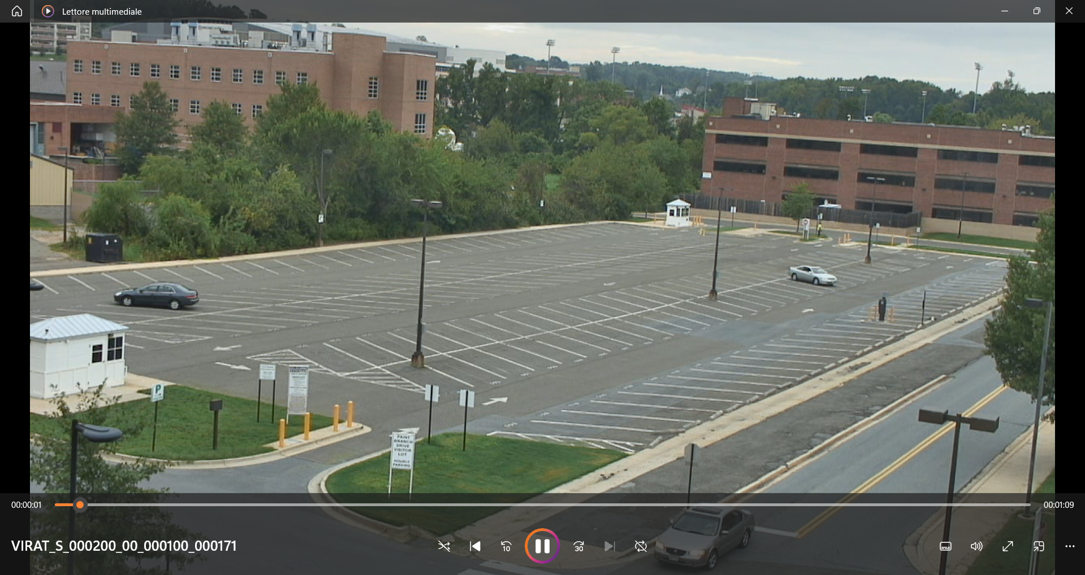
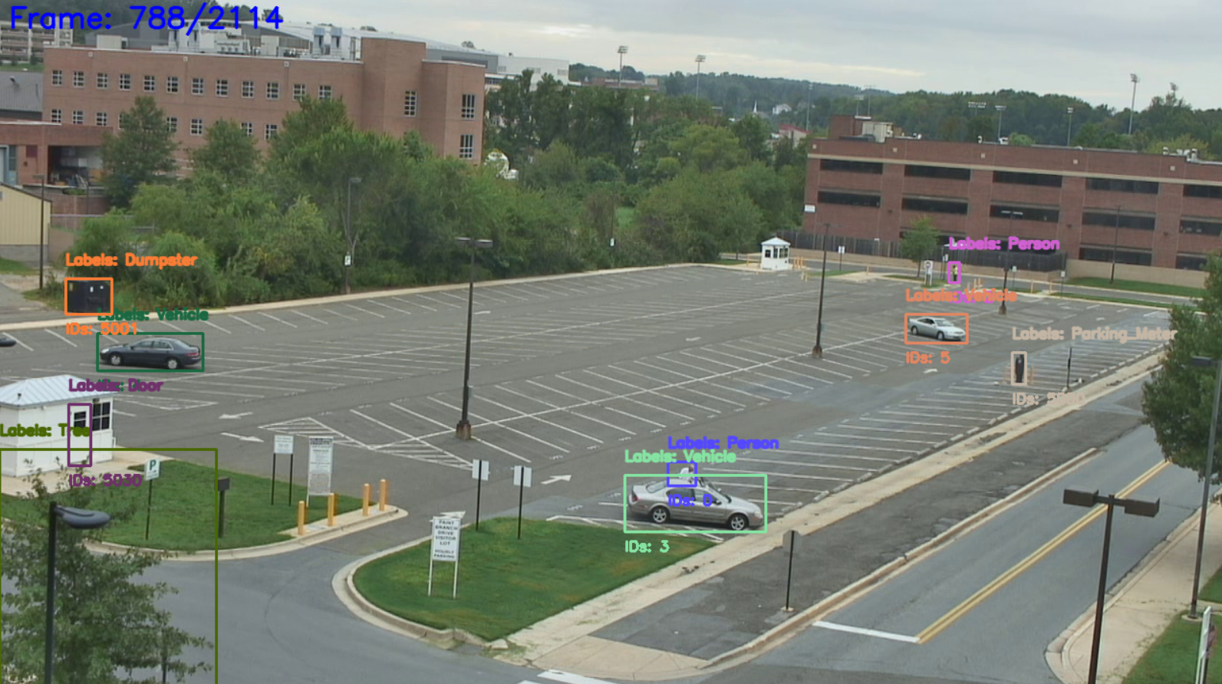
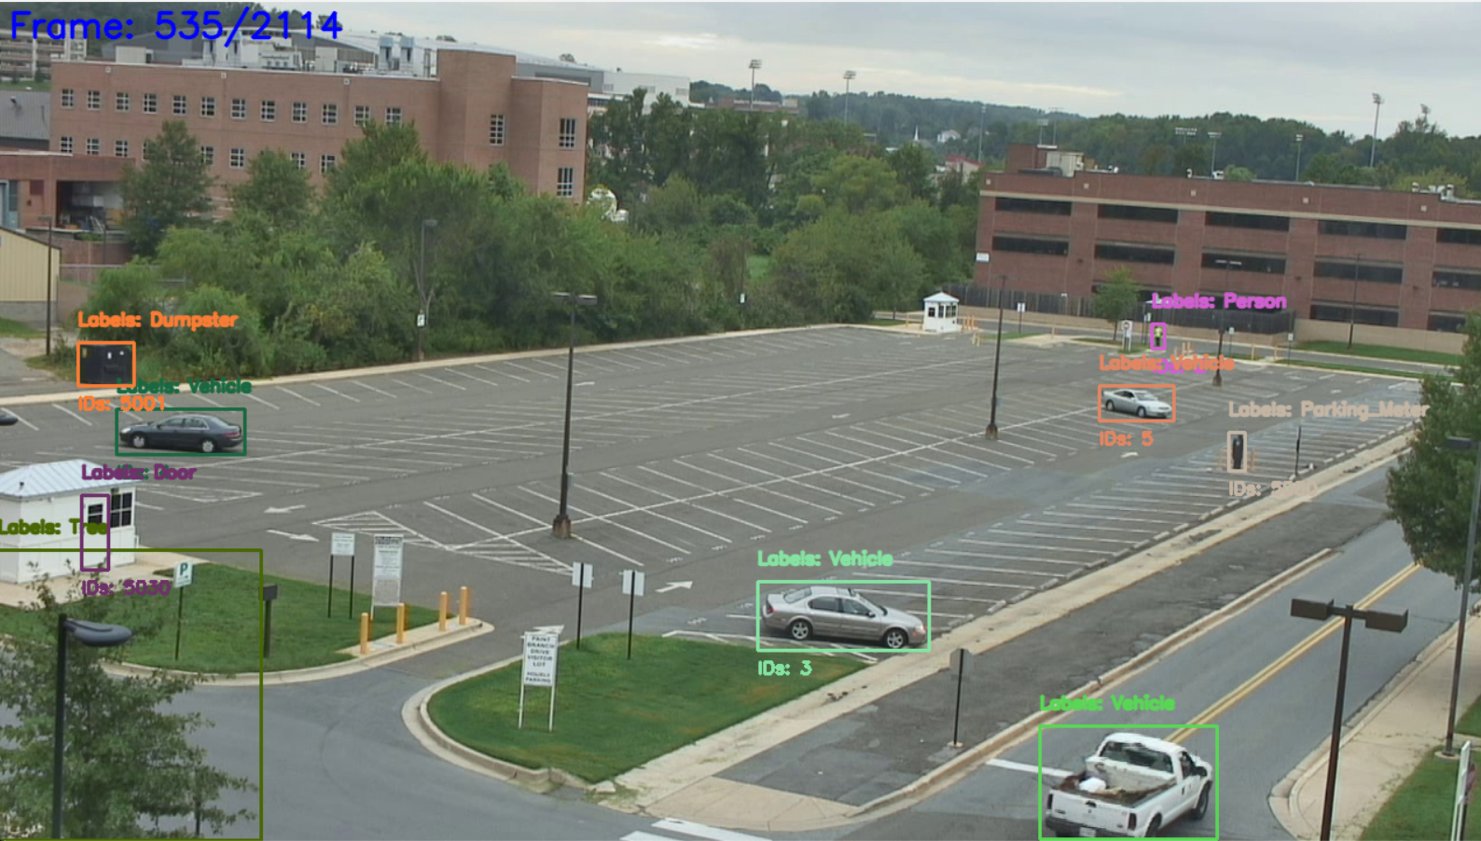
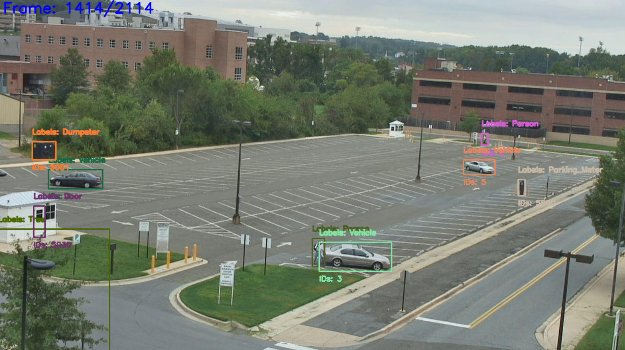
Virat Dataset
Dataset preprocessing for object tracking
Preprocessing steps:
Removed consecutive frames “too similar”. Similarity is measured by the average movement of the bounding boxes.
Frames sampled to images ( with sampling rate ) and for each a new annotation is created.
Single images processing: resizing, bilateral filtering and padding.

Slide 6
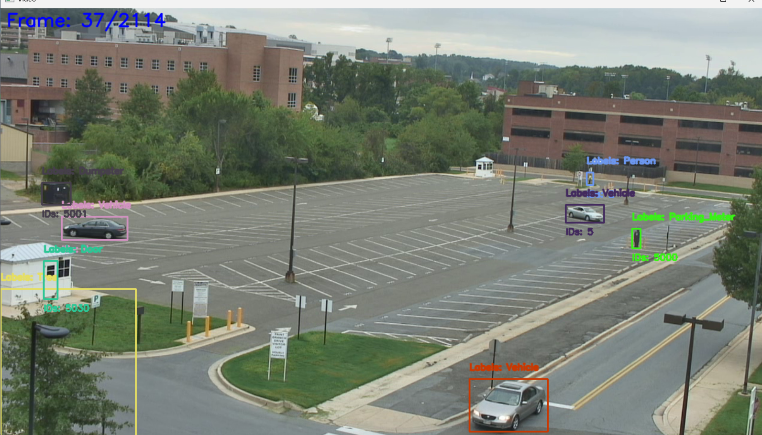
Virat Dataset
Dataset preprocessing for action recognition
Preprocessing steps:
Each video of the dataset is divided in N sub-videos, one for each registered action only keeping the frames in which the action is contained ( plus an offset )
The sub-videos are then cut only in the portions containing the event ( plus an offset in every direction ). Also random portions are extracted for the “No event” label.
Further processing is then done on the single videos to improve quality, to reduce size and to adapt it to the models. The steps are: frame sampling, resizing, bilateral filtering and padding.

Slide 7
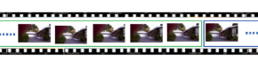
Proposed Method
Detector algorithm steps:
OBJECT
TRACKING
SLIDING
WINDOW
CLUSTERS
ZOOM-IN
ACTION RECOGNITION
Sliding window

Slide 8
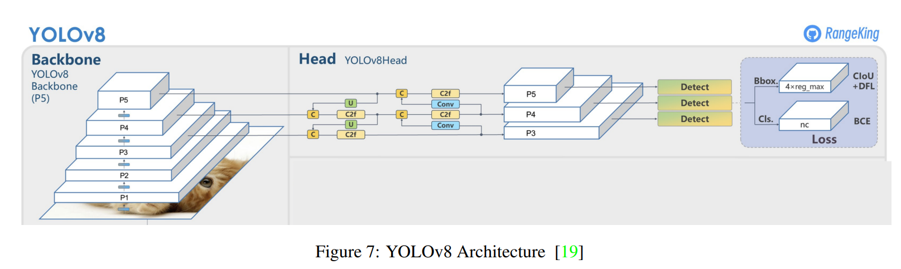
Object detection: YOLO
YOLOv8 architecture
BACKBONE: CSPDarknet53
NECK: FPN (Feature Pyramid Network), PAN (Path Aggregation Network)
HEAD: predictions
OUTPUT FORMAT-> tensor: (N,N,Bx(5+nc))
feature map -> NxN grid
anchor boxes x grid= B
Bounding Box = (x,y,w,h) + objectness score
nc = number of classes
[2305.09972] Real-Time Flying Object Detection with YOLOv8 (arxiv.org)

Slide 9
Object detection: YOLO
YOLOv8 Training
Data preprocessing:
PREPROCESSED IMAGES
PREPROCESSED ANNOTATIONS: ( label, x_center, y_center, width, height )
Fine-tuning:
pre-trained model by Ultralytics: yolov8m.pt: https://docs.ultralytics.com/models/yolov8/#how-do-i-train-a-yolov8-model
100 epochs
No data augmentation (large dataset)

Slide 10
METRICS
EPOCH | PRECISION | RECALL | mAP50 | mAP50-95
1OO th | 0.8875 | 0.65155 | 0.66074 | 0.56212

Slide 11
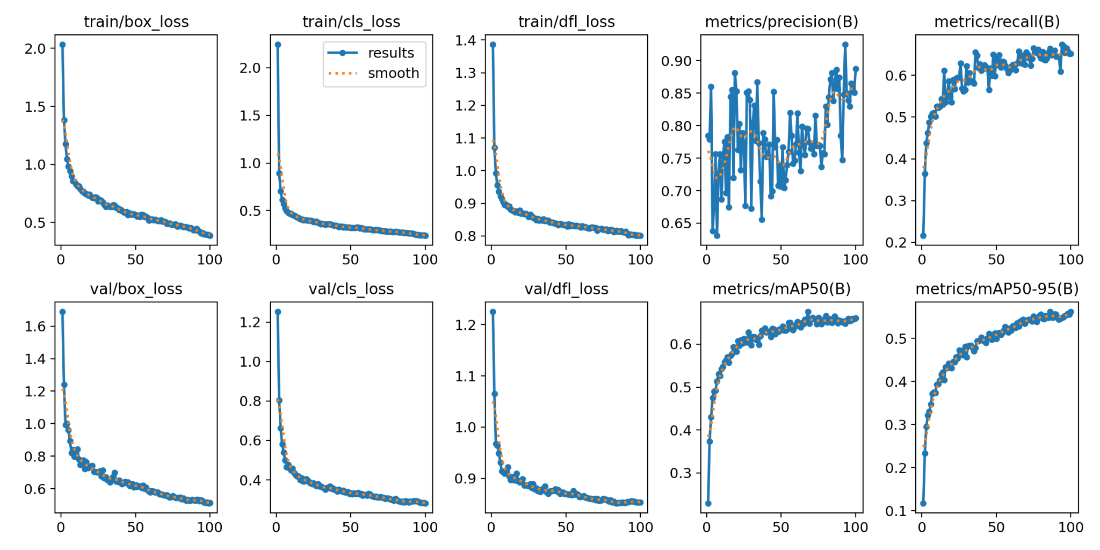
METRICS

Slide 12
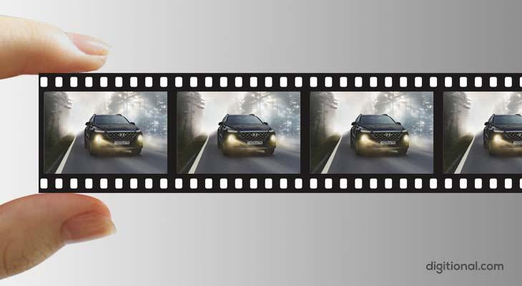
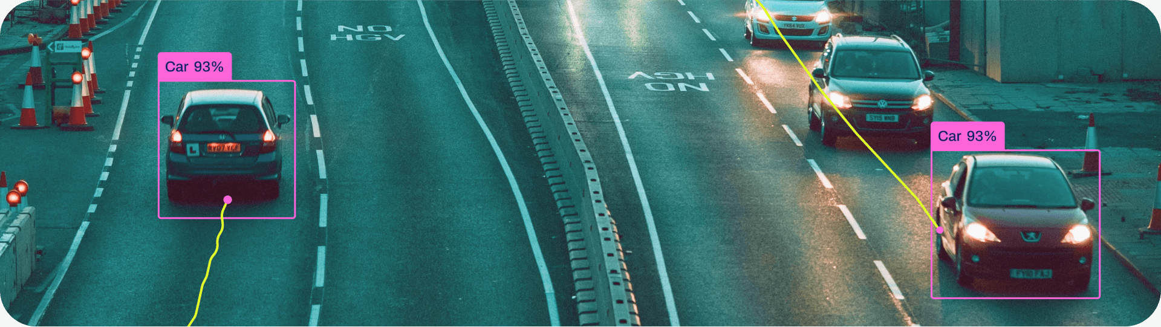
Object Tracking
oo
Tracking functionality integrated within the YOLO object detection framework.
TRACKS
INITIALIZATION WITH
UNIQUE IDS
YOLO
DETECTION MATCHING
TRACK UPDATE
OBJECT DETECTION
MODEL
detects objects in each frame
position
+
ID
OUTPUT:
INPUT:
video
or
sequence of frames

Slide 13
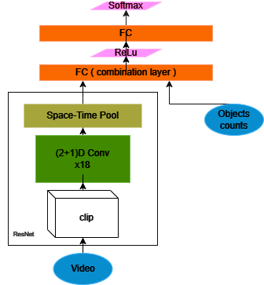
Action recognition
Model proposed
Architecture schema:
Video processed by a R2Plus1-18 model.
Objects count combined with video features
Fully Connected layer used for classification
R2Plus1-18 key points:
Uses (2+1)D residual convolutions - 2D convolution on space and 1D convolution on time..
18 layers of (2+1)D convolution
It’s pre-trained on the Kinetic dataset

Slide 14
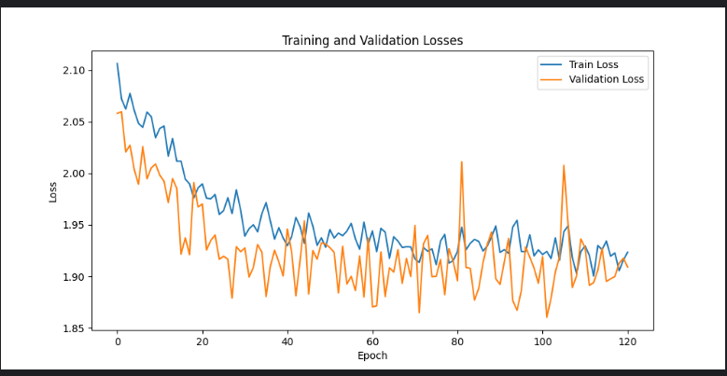
Action recognition
Model training process
Mostly for efficiency reasons:
All the layers have been frozen but the classifier and the last (2+1)D layer
Sub-portion of the dataset used
Only 12/41 event classes have been trained
Small batch size used
No data augmentation done
Accuracy | F1 Score | Recall | Precision
40.28% | 0.2926 | 25.37% | 40.28%
Model evaluation
LR | Optimizer | Batch Size | Epochs | Dataset Size | Sub-Dataset Size
0.001 | Adam | 2 | 120 | 4000 | 2000
Training settings

Slide 15
Final Considerations
The data and the training process have been scaled down considerably to compensate for the low performance of the available machines, impacting on final models’ accuracy. With better hardware, some improvements could have made by:
Downsampling less the images and videos
Data augmentation of videos and images
Noisy data for Action Recognition network ( for example wrong object counts )
Using more epochs, batch size and dataset size for the training process
Possibly adding a deeper classifier at the end of the Action Recognition network
Considering moving to a 3D convolution network for classification and comparing performances

Slide 16
Thanks for
your attention!

